Slide 1
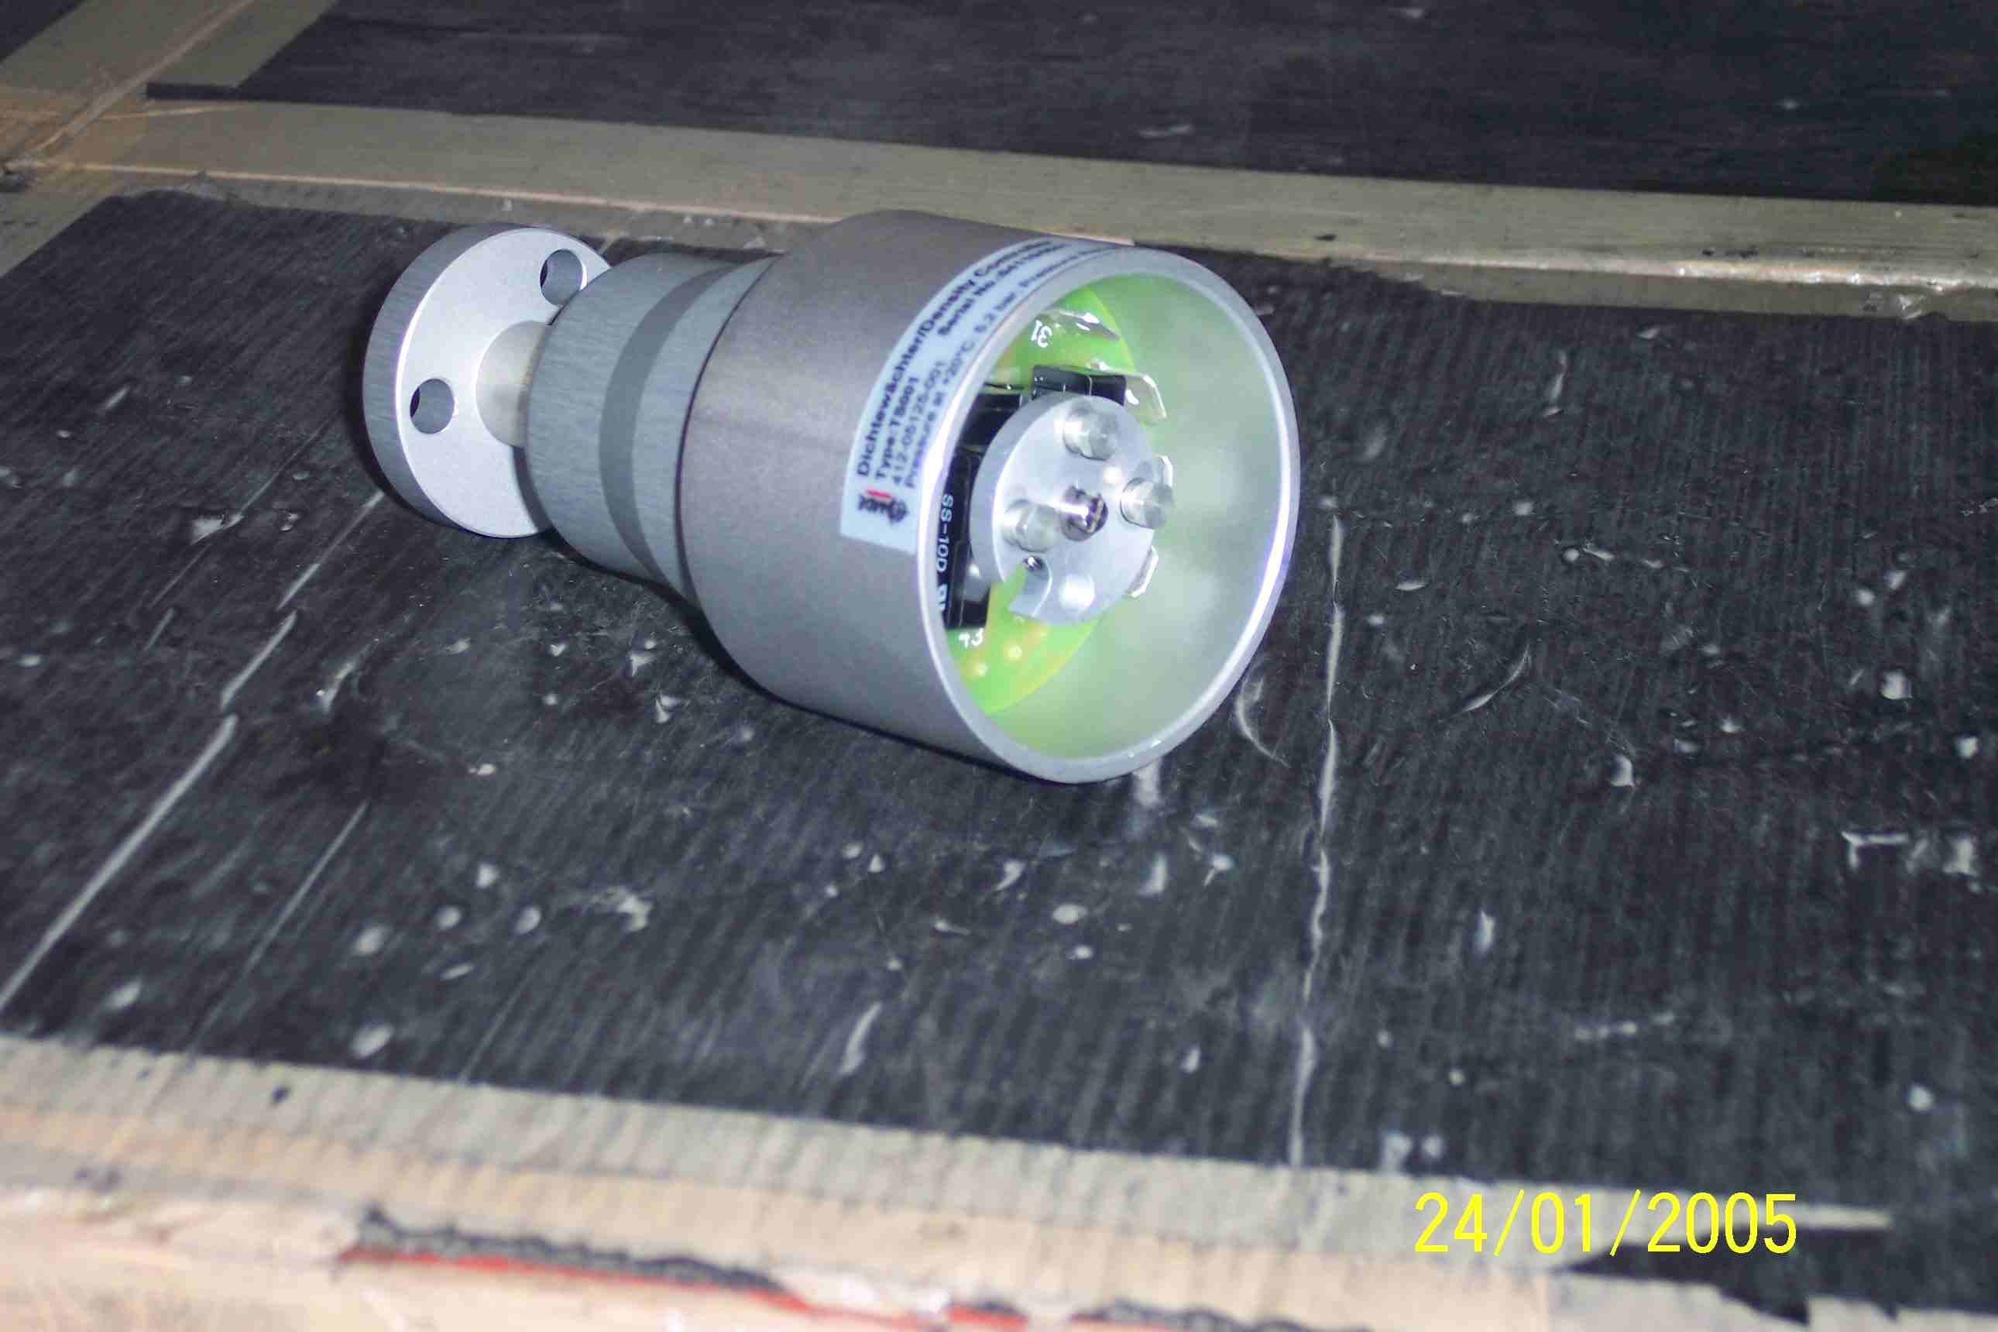
SIEMENS
HVCB SPARES
Gas Density Monitor
S4705072001
Same For 72.5KV, 145KV & 245 KV HVCBs

